Slide 1
MA 541 Final Project
By Gokul Kumar, Samruth Vennapusala, Aakil Kadali, & Nick Benelli

Slide 2

Part 1: Instructions
Data description – This data includes four columns/random variables: the daily ETF return; the daily relative change in the price of the crude oil; the daily relative change in the gold price; and the daily return of the JPMorgan Chase & Co stock. The sample size is 1000.
Requirements – Use any software to obtain the sample mean and sample standard deviation for each random variable (column) of the data; the sample correlations among each pair of the four random variables (columns) of the data.

Slide 3
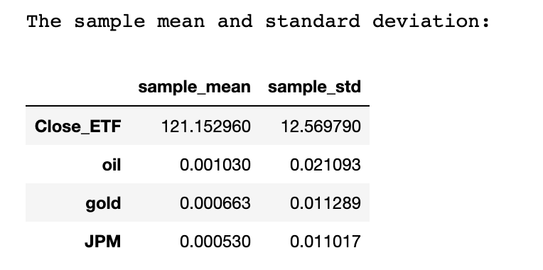
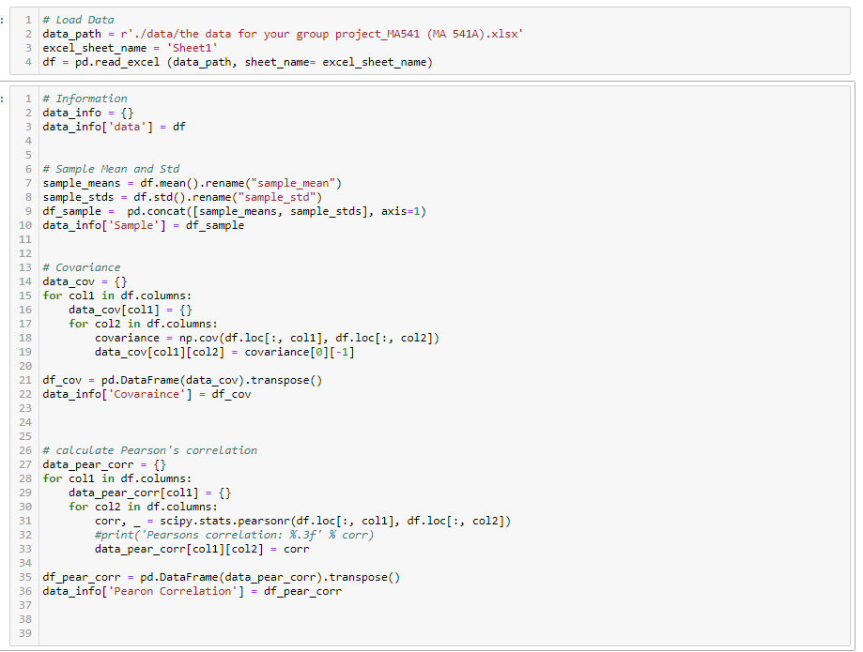
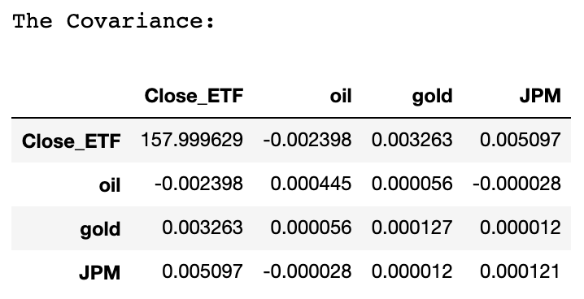
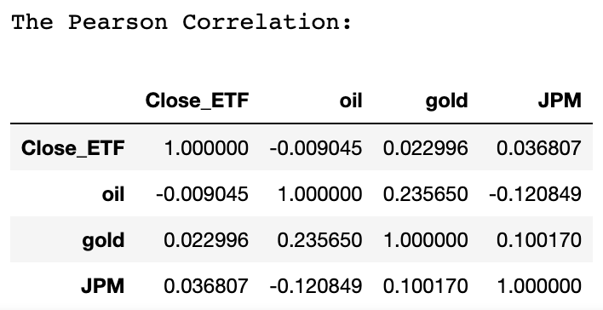
Part 1: Code and Results

Slide 4
Part 1 Summary:
The first observations can be made about this data. First, the Close_ETF has a much larger mean and standard deviation than any of the three categories. The means for the other 3 categories are below 1. Also, the Pearson correlation data shows that none of the data is highly correlated or correlated at all.

Slide 5
Part 2: Instructions
Requirements – Use any software to draw the following plots:
1) A histogram for each column (hint: four histograms total)
2) A time series plot for each column (hint: use the series “1, 2, 3, …, 1000” as the horizontal axis; four plots total)
3) A time series plot for all four columns (hint: one plot including four “curves” and each “curve” describes one column)
4) Three scatter plots to describe the relationships between the ETF column and the OIL column; between the ETF column and the GOLD column; between the ETF column and the JPM column, respectively

Slide 6
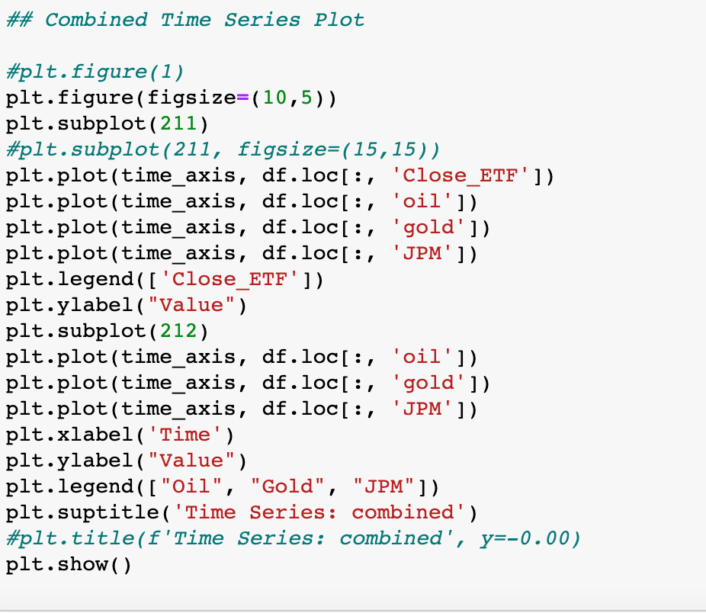
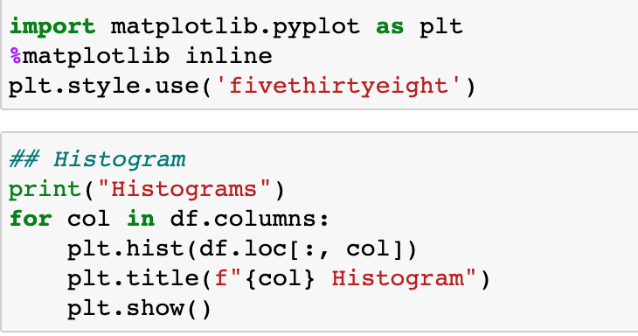
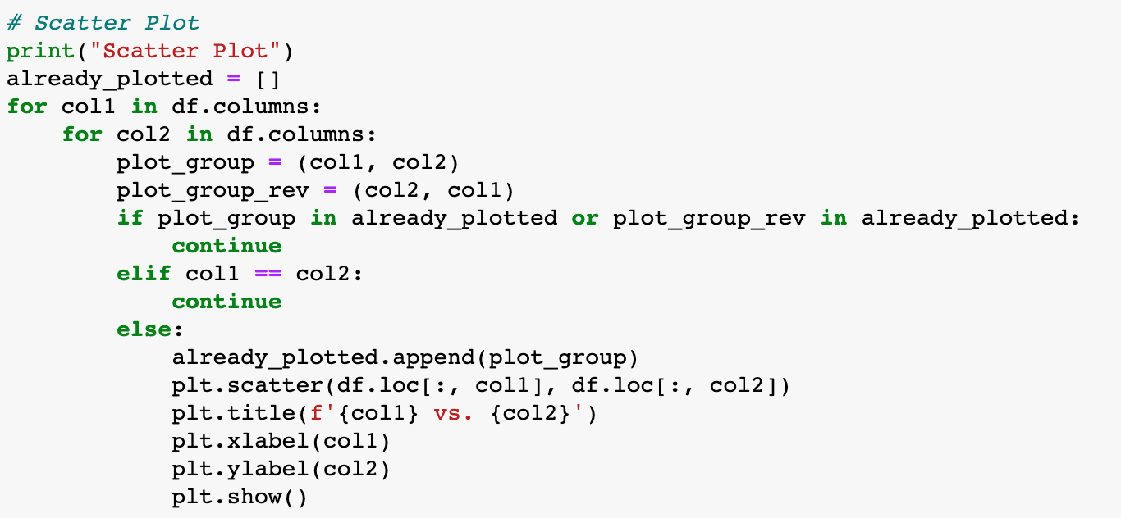
Code

Slide 7
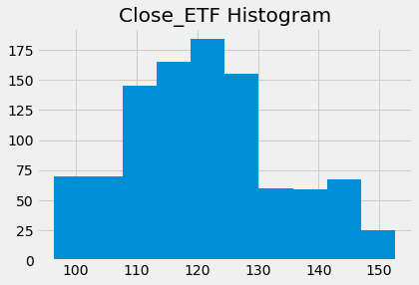
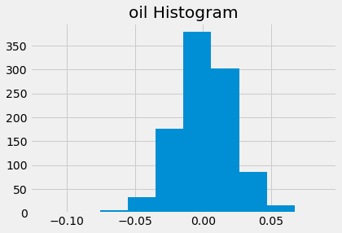
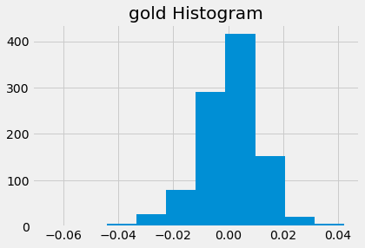
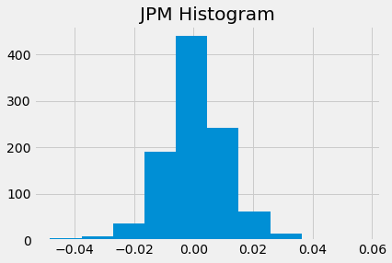
Histogram Plots

Slide 8
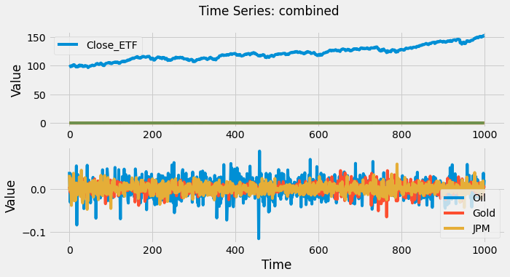
Time Series Plots

Slide 9
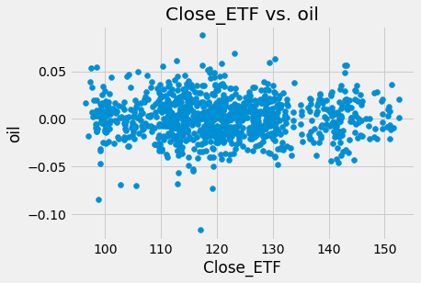
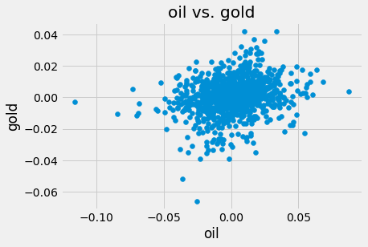
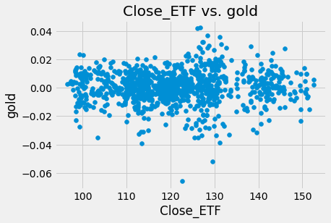
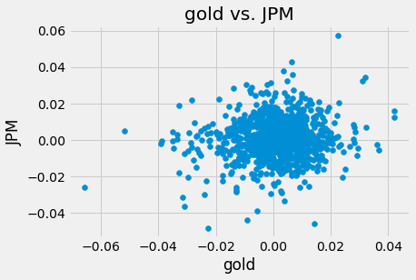
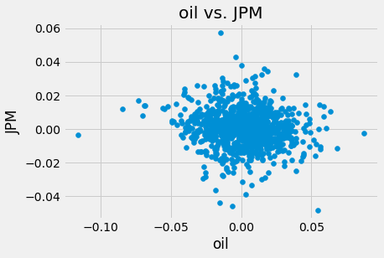
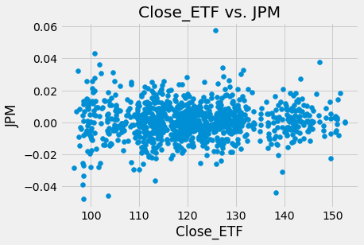
Scatter Plots

Slide 10
Part Summary:
The main takeaway is that the histograms show the data can follow a bell-curve normal distribution. The main takeaway is from the time series plots. First, it can easily be seen how much greater Close ETF is than oil, gold, and JPM. Close ETF tends to grow steadily over time, while the other categories tend to fluctuate over time. There is no relationship between each category in the scatter plot.

Slide 11
Part 3: Instructions
Requirements – Propose an assumption/a hypothesis regarding the type of distribution each column of the data set may follow (i.e., the ETF, OIL, GOLD, and JPM column), based on the plots from Part 2. Then verify or object that assumption/hypothesis with appropriate tests (for example, normality test). You may use any software to perform those tests.

Slide 12
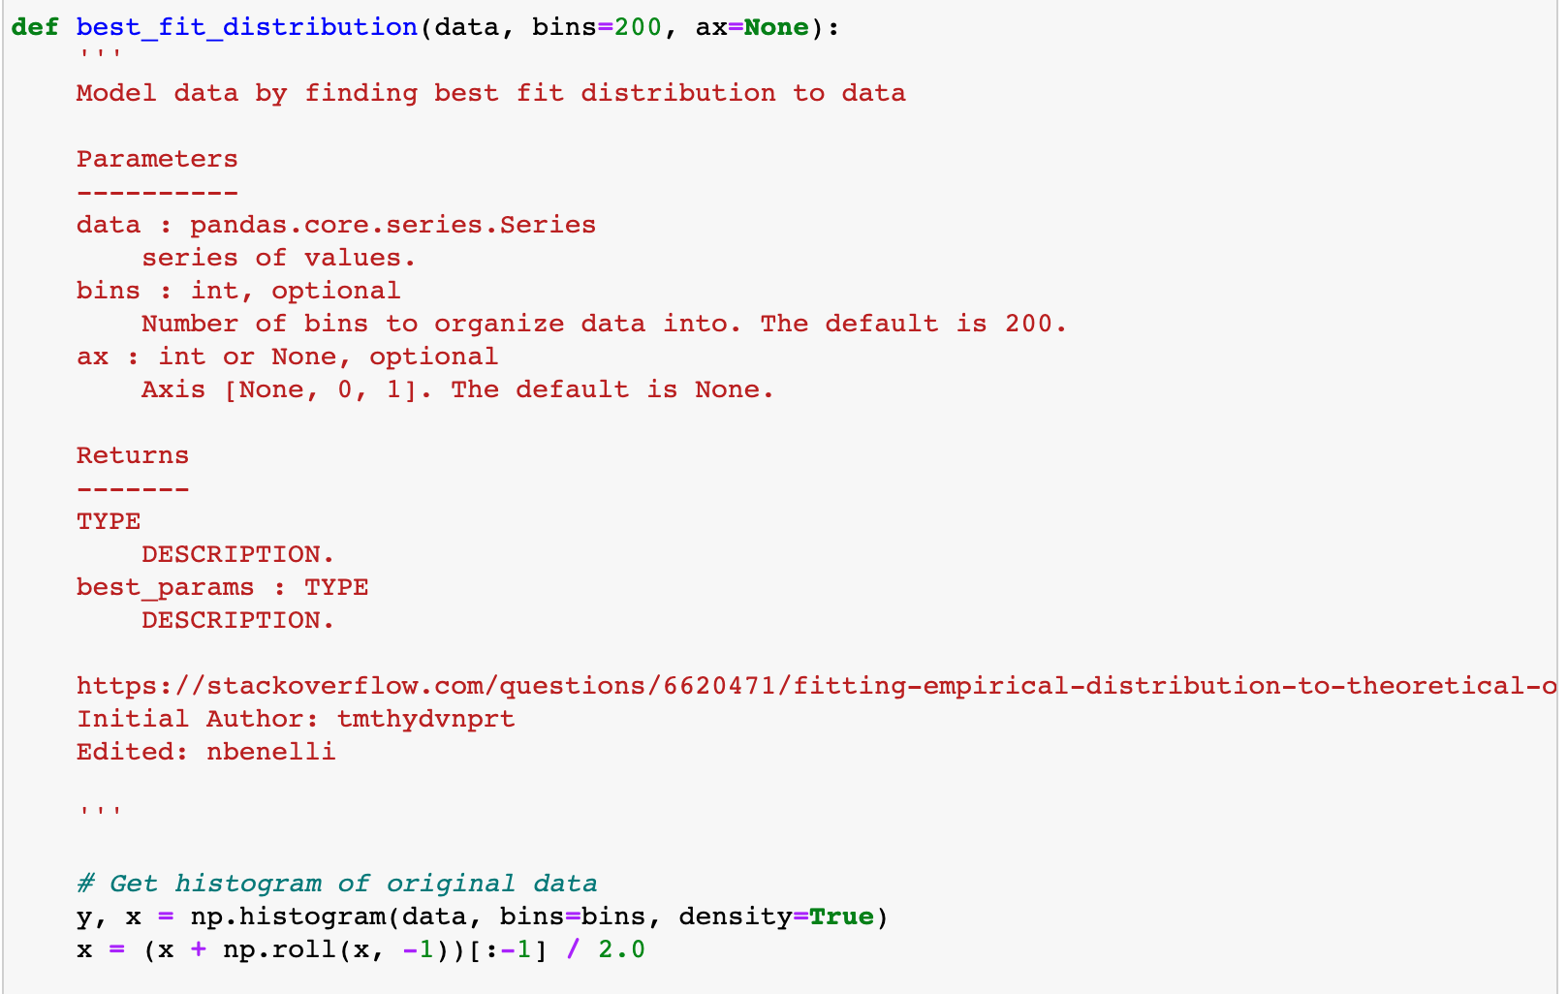
Code

Slide 13
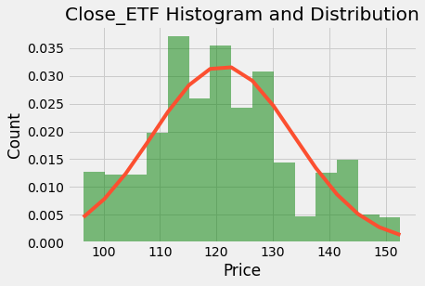
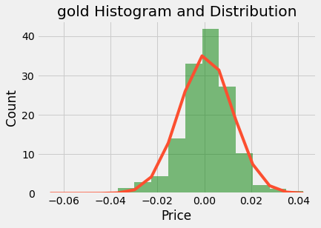
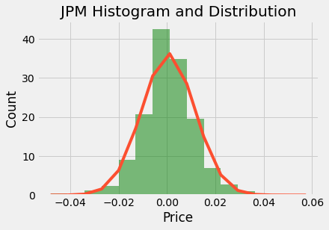
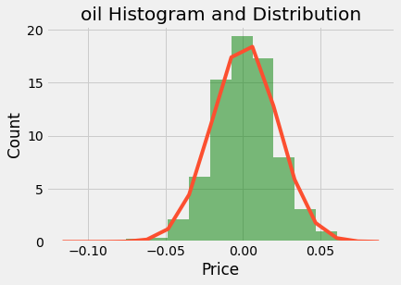
Histograms with Best Fit

Slide 14
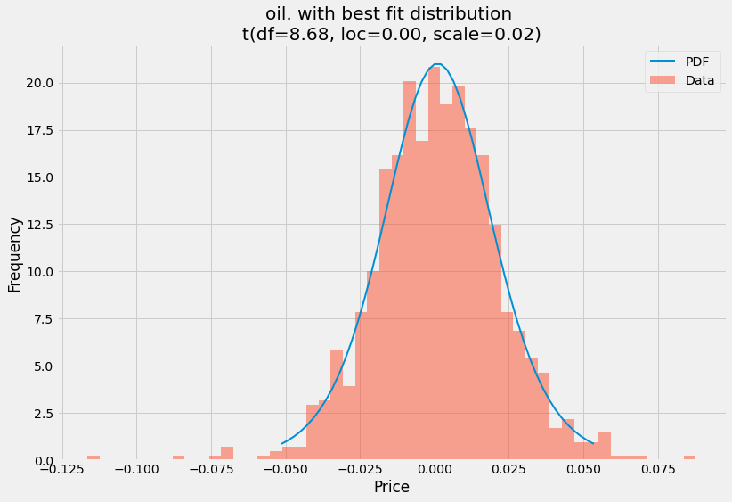
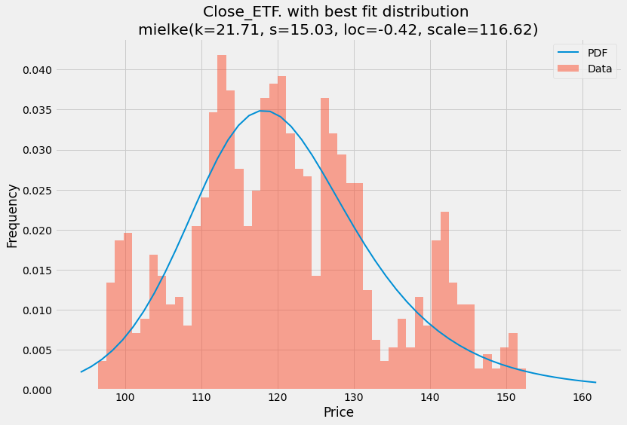
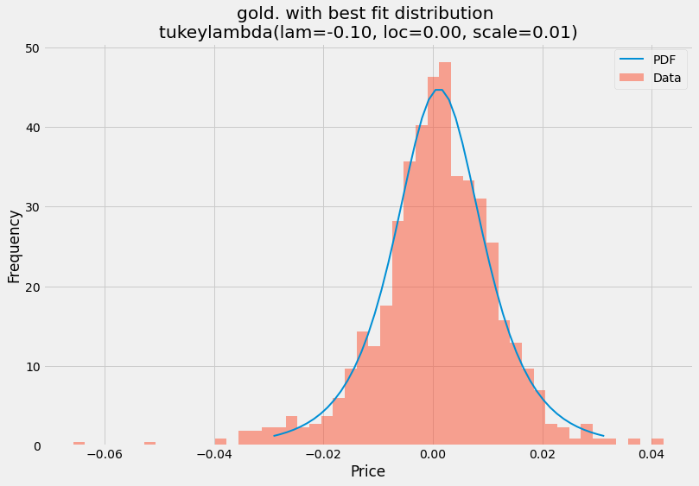
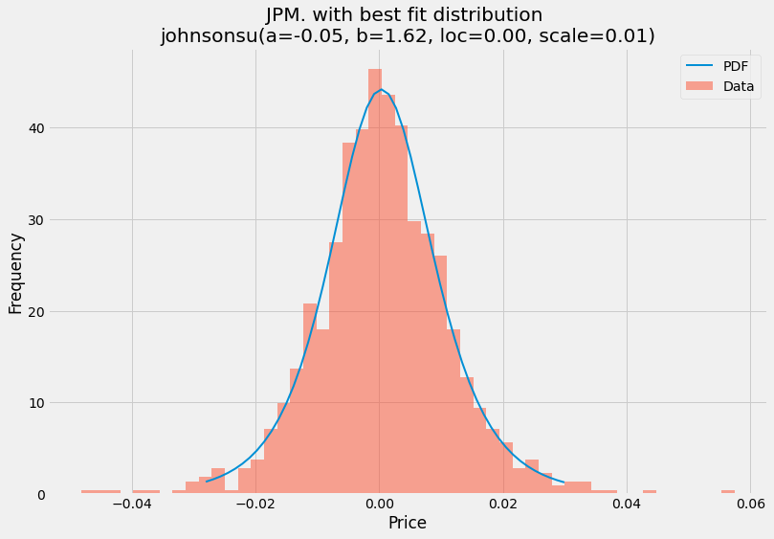
Normalized Histograms with Selected Distributions

Slide 15
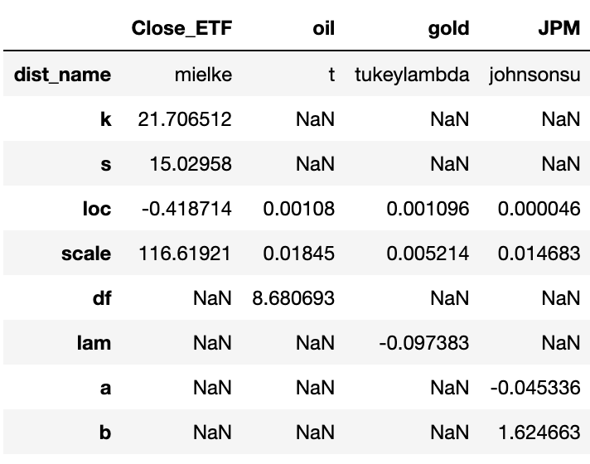
Distribution Parameter Data Frame

Slide 16
Part Summary
The original hypothesis is that each category followed a normal distribution, with gold being right-skewed. The best_fit_distribution function will compare the data to 86 distributions in the scipy python package. The function will return the best fitting distribution with the appropriate parameters. The function assumes a normal distribution and compares each distribution. If a distribution fits better than the current distribution, then the distribution is replaced.
Close ETF best follows a Mielke Beta-Kappa / Dagum continuous random variable distribution with the parameters k = 21.7 and s = 15.029. Oil follows a t distribution. The loc and scale parameters are 0.00108 and 0.018 respectively. Gold follows a Tukey lambda distribution. The lambda parameter is -0.097. Finally, JPM is a Johnson SU continuous random variable with parameters a=-0.045 and b=1.62.
You can see from the normalized histogram plots how well each distribution fits. The probability density function is the bell curve while the data is the bar graphs in the histogram plot. The Close-ETF might have the worst fit of all the distributions.

Slide 17
Part 4: Instructions
Requirements – Consider the ETF column (1000 values) as the population (x), and do the follows. Any software may be used. Statistical Methods 1) Calculate the mean and the standard deviation of the population.
2) Break the population into 50 groups sequentially and each group includes 20 values.
3) Calculate the sample mean of each group. Draw a histogram of all the sample means. Comment on the distribution of these sample means, i.e., use the histogram to assess the normality of the data consisting of these sample means.
4) Calculate the mean and the standard deviation of the data including these sample means. Make a comparison between �! and �! , between #! √% and �! . Here, � is the number of sample means calculated from Item 3) above.
5) Are the results from Items 3) and 4) consistent with the Central Limit Theorem? Why?
6) Break the population into 10 groups sequentially and each group includes 100 values.
7) Repeat Items 3) ~ 5).
8) Generate 50 simple random samples or groups (with replacement) from the population. The size of each sample is 20, i.e., each group includes 20 values.
9) Repeat Items 3) ~ 5).
10) Generate 10 simple random samples or groups (with replacement) from the population. The size of each sample is 100, i.e., each group includes 100 values.
11) Repeat Items 3) ~ 5).
12) In Part 3 of the project, you have figured out the distribution of the population (the entire ETF column). Does this information have any impact on the distribution of the sample mean(s)? Explain your answer.

Slide 18
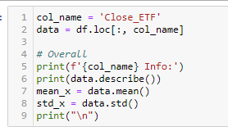
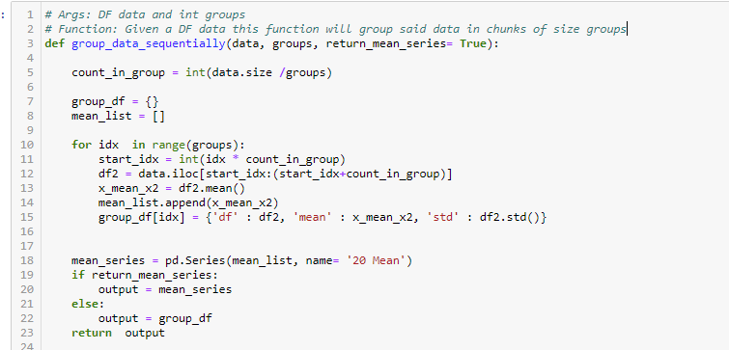
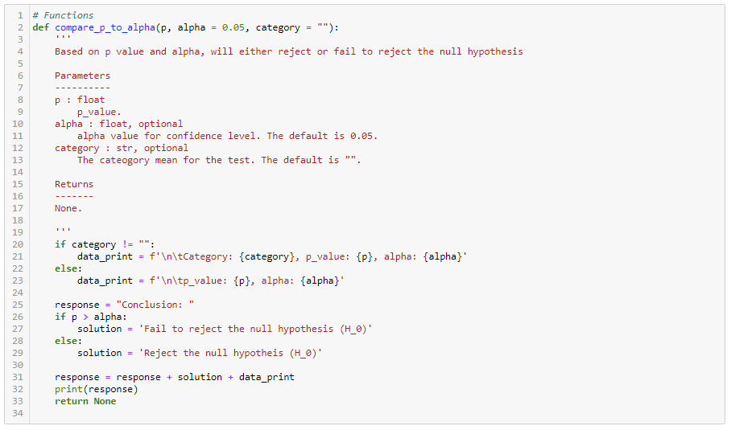
Part 4 Code: Numbers 1-2

Slide 19
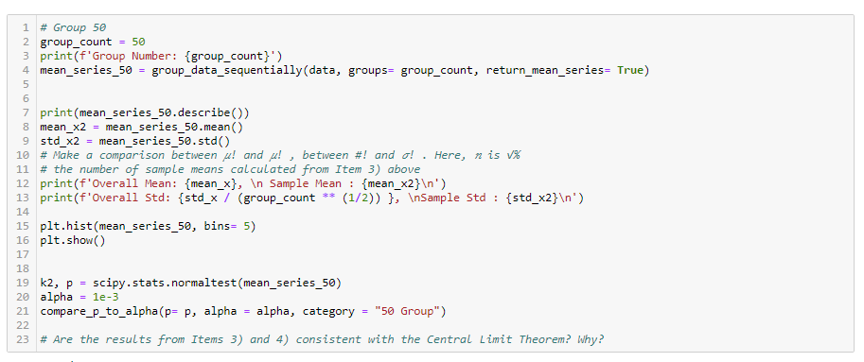
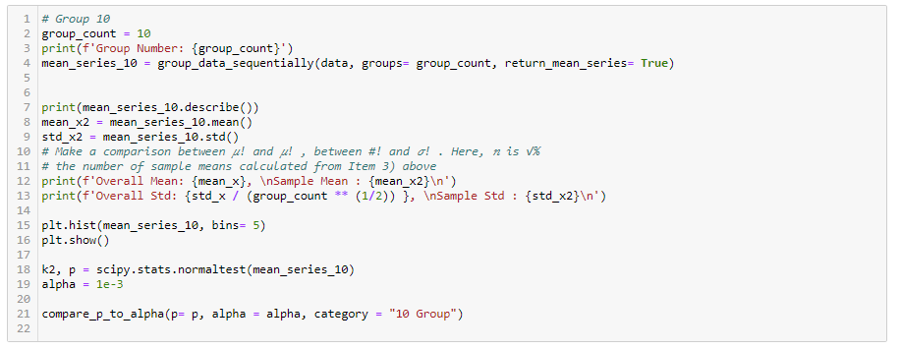
Part 4 Code: Numbers 3-4, 5-6

Slide 20
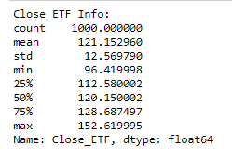
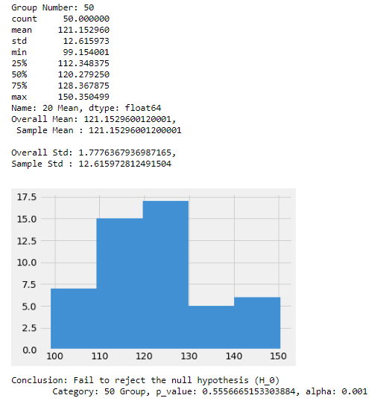
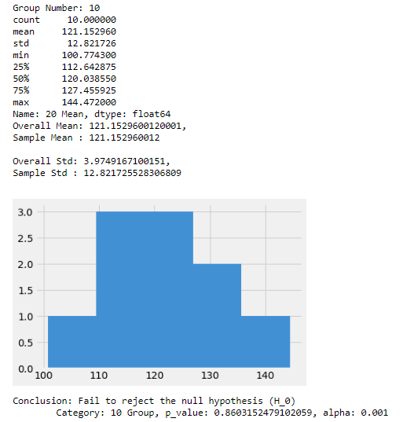
Part 4: Results for 1,3,4,5,6

Slide 21
Part 4: Number 5 (Analysis)
Are the results from Items 3) and 4) consistent with the Central Limit Theorem? Why?
They are since when we run the normality test on the 50 and 10 Group with the null hypothesis, we see that We cannot reject the hypothesis which means the distributions of sample means follow a normal distribution which by definition proves the Central Limit Theorem

Slide 22
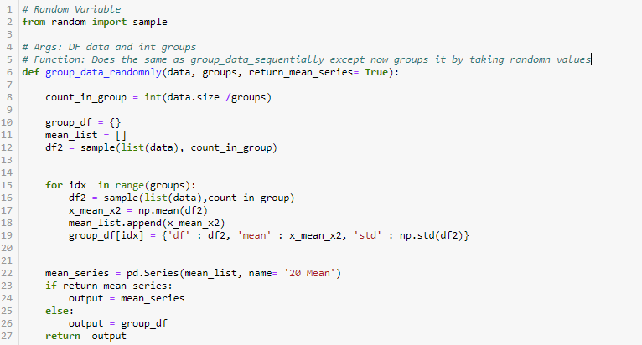
Part 4 Code: Numbers 8-11

Slide 23
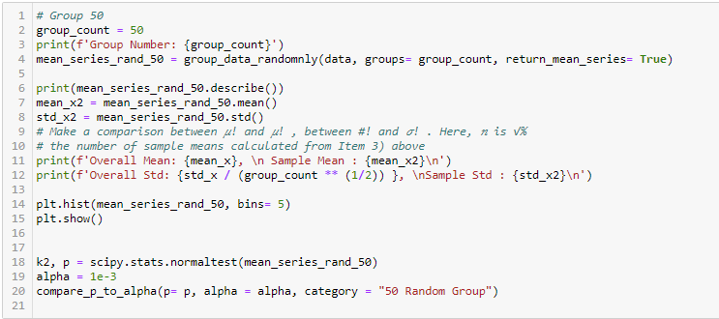
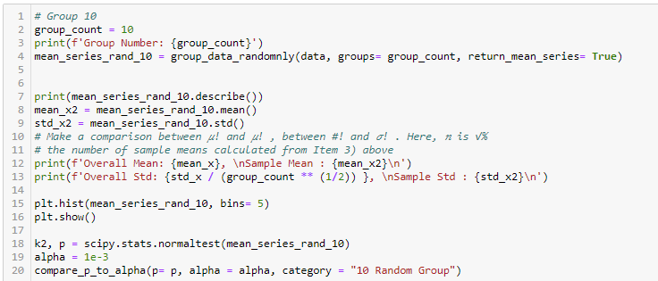
Part 4 Code: Numbers 8-11 cont.

Slide 24
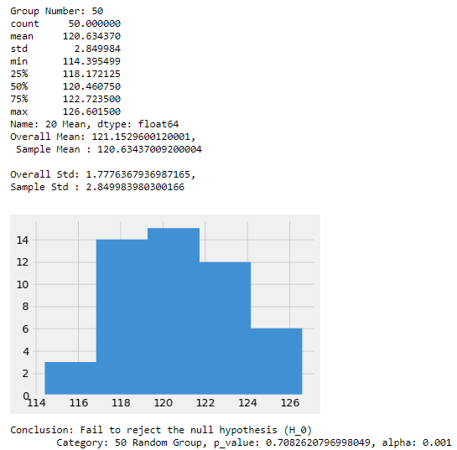
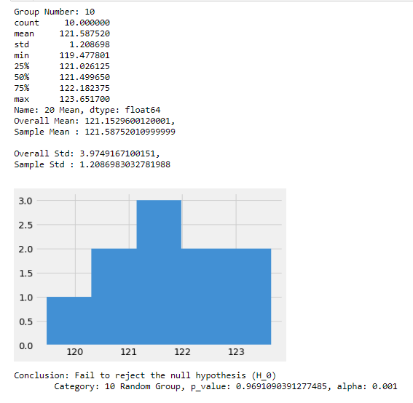
Part 4: Results for 8-11

Slide 25
Part 4 Summary: Question 12
12) In Part 3 of the project, you have figured out the distribution of the population (the entire ETF column). Does this information have any impact on the distribution of the sample mean(s)? Explain your answer.
No it the distributions should not affect the sample mean distribution. This is because it follows the central limit theorem. The central limit theorem states that if you have a population with mean μ and standard deviation σ and take sufficiently large random samples from the population with replacement text annotation indicator, then the distribution of the sample means will be approximately normally distributed.

Slide 26
Part 5: Instructions
1) Pick up one of the 10 simple random samples you generated in Step 10) of Part 4, construct an appropriate 95% confidence interval of the mean �.
2) Pick up one of the 50 simple random samples you generated in Step 8) of Part 4, construct an appropriate 95% confidence interval of the mean �.
3) In Part 1, you have calculated the mean � of the population (the entire ETF column) using Excel function. Do the two intervals from 1) and 2) above include (the true value of) the mean �? Which one is more accurate? Why?

Slide 27
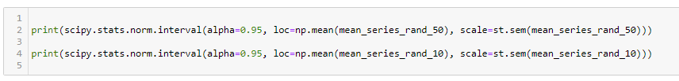
Part 5: Code

Slide 28

Part 5 Results

Slide 29
Part 5 Summary: Question 3
3) In Part 1, you have calculated the mean 𝜇 of the population (the entire ETF column) using Excel function. Do the two intervals from 1) and 2) above include (the true value of) the mean 𝜇? Which one is more accurate? Why?
121.152960 was the mean of the entire ETF data set. This value is contained within both our confidence intervals for the group of 10 and group of 50. I believe the 50 group would be more accurate as it contains more of the initial ETF data which allows the sample mean and std to be close to the actual mean and std

Slide 30
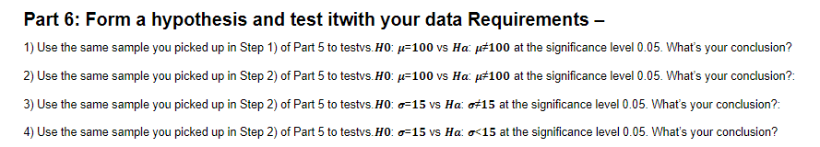
Part 6: Instructions
In this part we want to use different hypothesis tests to test the given hypotheses. We used the T test and the F test.
We used the T- test when we were testing the hypothesis for a mean value, to get the T-statistic and the P-value of the distribution. We used the F-test when we were testing the hypothesis for a given standard deviation. We get the F-statistic and the P-value of the distribution. We do a 2-sided test for all of the parts except for part 4 and we are only looking at standard deviation < 15 in the alternative hypothesis.

Slide 31
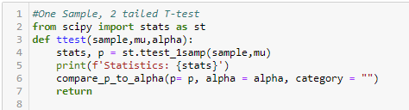
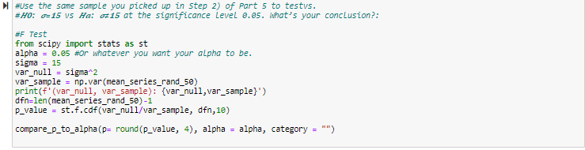
Part 6: Code

Slide 32
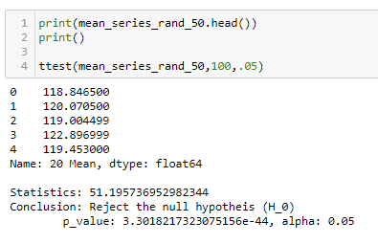
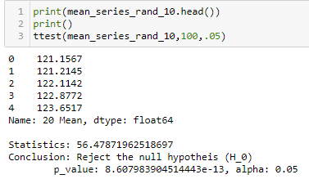
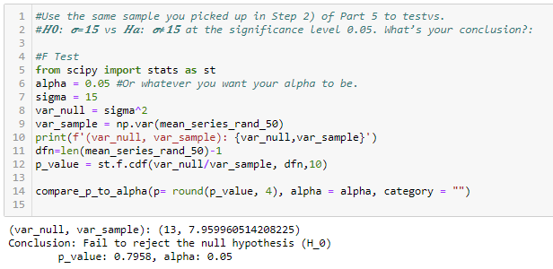
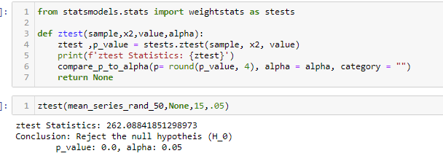
Part 6: Results

Slide 33
Part 7: Instructions
1) Consider the entire Gold column as a random sample from the first population, and the entire Oil column as a random sample from the second population. Assuming these two samples be drawn independently, form a hypothesis and test it to see if the Gold and Oil have equal means in the significance level 0.05.
2) Subtract the entire Gold column from the entire Oil column and generate a sample of differences. Consider this sample as a random sample from the target population of differences between Gold and Oil. Form a hypothesis and test it to see if the Gold and Oil have equal means in the significance level 0.05.
3) Consider the entire Gold column as a random sample from the first population, and the entire Oil column as a random sample from the second population. Assuming these two samples be drawn independently, form a hypothesis and test it to see if the Gold and Oil have equal standard deviations in the significance level 0.05.

Slide 34
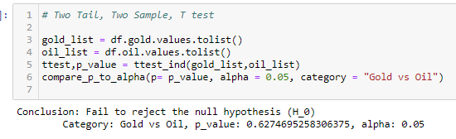


Part 7: Code/Results

Slide 35
Part 8: Instructions
Consider the data including the ETT column and Gold column only. Using any software,
1) Draw a scatter plot of ETF (Y) vs. Gold (X). Is there any linear relationship between them which can be observed from the scatter plot?
2) Calculate the coefficient of correlation between ETF and Gold and interpret it.
3) Fit a regression line (or least squares line, best fitting line) to the scatter plot. What are the intercept and slope of this line? How to interpret them?
4) Conduct a two-tailed t-test with �(: �) = 0. What is the P-value of the test? Is the linear relationship between ETF (Y) and Gold (X) significant at the significance level 0.01? Why or why not?
5) Suppose that you use the coefficient of determination to assess the quality of this fitting. Is it a good model? Why or why not?
6) What are the assumptions you made for this model fitting?
7) Given the daily relative change in the gold price is 0.005127. Calculate the 99% confidence interval of the mean daily ETF return, and the 99% prediction interval of the individual daily ETF return.

Slide 36





Part 8: Code and Results Numbers 1-4

Slide 37

Part 8: Code and Results Numbers 5-6

Slide 38


Part 8: Code and Results Numbers 7

Slide 39
Part 9: Instructions
Consider the data including the ETF, Gold and Oil column. Using any software, fit a multiple linear regression model to the data with the ETF variable as the response. Evaluate your model with adjusted �*.

Slide 40

Code

Slide 41

Singular Regression Correlation

Slide 42

Linear Regression
Train R Squared: 0.000273
Test R Squared: -0.0043

Slide 43

Anova Table

Slide 44
Part Summary
Ultimately the model is not very predictive. This would make sense, because each independent variable does not have a strong correlation with the dependent variables. Multi-variable linear regression models work best when all independent variables are moderately predictive. Together they can provide a strong correlation.

Slide 45
Part 10: Instructions
Calculate the residuals of the model fitting you did in Part 9. Check the four assumptions made for the error terms of the multiple regression model using these residuals (mean 0; constant variance; normality; and the independence). You may draw some plots over the residuals to check these assumptions. For example, draw a Normal Probability Plot to check the normality assumption; draw a scatter plot of Residuals vs. Fitted Values to check the constant variance assumption and the independence assumption; and so on. You may refer to the following link https://www.youtube.com/watch?v=4zQkJw73U6I for some hints. In your project report, all the relevant plots and at least one paragraph of summary of checking the four assumptions using those plots must be included. Discuss how you may improve the quality of your regression model according to the strategy of model selection.

Slide 46

Code

Slide 47

Residuals

Slide 48

OLS Regression

Slide 49


Slide 50

Q-Q Plot

Slide 51
Part Summary
The Q-Q plot shows the sample quantiles follow a normal distribution.
Ultimately, the assumptions of the linear regression model do hold up, but the linear regression model is just not very predictive.
Different techniques can improve the regression model. Adjusted and predicted R-squared values can find relationships between dependent and independent variables. P-values can find independent variables. Finally, stepwise regression and best subsets can help filter the data to find a relationship.

